Slide 1

DISCRETE MATHEMATICS
Chapter 4:
REGRESSION COEFFICENT
Presenter: Ph.D. Phu-Nguyen Le
June 7th, 2023
1

Slide 2
Introduction
4.1 DEFINITION.
4.1.1. Define the retrieval coefficient.
4.1.2. Solution of the regression coefficient
4.2. SOLVE THE PROBLEM WITH THE MODEL OF REGRESSION.
2

Slide 3

4.1 DEFINITION
4.1.1. Define the retrieval coefficient.
Suppose you are waiting in line
3

Slide 4

4.1 DEFINITION
4.1.1. Define the retrieval coefficient.
… a very long line
4

Slide 5

4.1 DEFINITION
4.1.1. Define the retrieval coefficient.
You want to determine how many people are in front of you, but:
You cannot see
You’re not allowed to move.
You are only allowed to speak to the person in front of you and behind you.
How do you do it?
5

Slide 6
4.1 DEFINITION
4.1.1. Define the retrieval coefficient.
Recursion
A programming technique that breaks down a complex problem into smaller, manageable pieces
Recursive solutions solve a problem by applying the same algorithm to each piece and then combining the results.
Define the problem by itself
6

Slide 7
4.1 DEFINITION
4.1.1. Define the retrieval coefficient.
General formula:
people in front of person in front of you + person in front of you = people in front of you
The Solution
Tap the shoulder of the person in front of you and ask how many people are in front of him/her
Wait for his/her response and add 1
If someone asked, tell them how many people are in front of you
7

Slide 8
4.1 DEFINITION
4.1.1. Define the retrieval coefficient.
A Diagram
Ask and wait
Ask and wait
Ask and wait….
…. Reached first in line. Tell person behind it is 0.
Tell person behind it is 0+1
Tell person behind it is 1+1…
Tell Person behind it is x +1
8

Slide 9
4.1 DEFINITION
4.1.1. Define the retrieval coefficient.
Recursive Algorithms
There are two main components to recursive algorithms
1) Base Case: The point where you stop applying the recursive case
2) The Recursive Case : The set of instructions that will be used over and over
9

Slide 10
4.1 DEFINITION
4.1.1. Define the retrieval coefficient.
Base Case: 1 is an odd positive integer
Recursion: if k is an odd positive integer, than k+2 is an odd positive integer
Explain the definition base?
K=1? K=3?
What is the main idea of it?
10

Slide 11
4.1 DEFINITION
4.1.1. Define the retrieval coefficient.
Example : f(0)=3
f(n+1)= 2f(n)+3
Find f(1), f(2), f(3), and, f(4),
Example: factorial of n: n!
Example: The Fibonacci numbers
Example: factorial of n: n!
11

Slide 12
4.1 DEFINITION
4.1.1. Define the retrieval coefficient.
A function is said to be recursively defined if the function refer to itself such that:
1. There are certain arguments, called base values, for which the function does not refer to itself
2. Each time the function does refer to itself, the argument of the function must be closer to the base value
12

Slide 13









4.1 DEFINITION
4.1.1. Define the retrieval coefficient.
Within the function body there is only one function call that explicitly calls itself.
Linear
1
In the function body there are two function calls that explicitly call itself.
Binary
2
Mutual
In one function body there is a function call to another function and inside the other function body there is a function call to this function.
Non linear
3
4
In the function body there is the function callback itself placed inside the loop body.
13
13
Notes:
Đệ quy tuyến tính (Linear Recursion)
Mỗi lần thực thi chỉ gọi đệ quy một lần
Đệ quy nhị phân (Binary Recursion)
Mỗi lần thực thi có thể gọi đệ quy 2 lần
Đệ quy lồng (Nested Recursion)
Tham số trong lời gọi đệ quy là một lời gọi đệ quy, đệ quy lồng chiếm bộ nhớ rất nhanh.
Đệ quy hỗ tương (Mutual Recursion)
Các hàm gọi đệ quy lẫn nhau
Ví dụ xét tính chẵn lẻ của một số nguyên dương bằng đệ quy.

Slide 14

4.1 DEFINITION
4.1.2. Solution of the regression coefficient
A linear recursive relation of order k is a system:
$$a0xn + a1xn−1 +… akxn−k = fn (1)$$
a₀, a₁ , ..., an are the real coefficients; {f_{n} } is a given sequence of real numbers and {x_{n} } is a hidden sequence of real values
In case the sequence f_{n}=0 for all n then (1) becomes a₀x_{n} + a₁x_{n-1} +… a_{k}x_{n-k} = 0 (2) We say (2) is a homogeneous linear recursive relation of order k.
$a0xn + a1xn−1 +… akxn−k =0 (2)$
13
Notes:
a0  0, a1 ,…, an là các hệ số thực; {fn } là một dãy số thực cho trước và {xn } là dãy ẩn nhận các giá trị thực
2 là phương trình đệ quy thuần nhất tuyến tính cấp k hệ số hằng

Slide 15
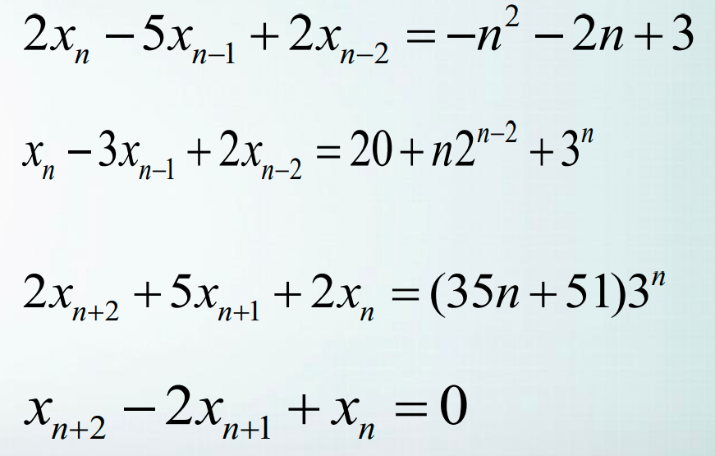
4.1 DEFINITION
4.1.2. Solution of the regression coefficient
Examples:
14

Slide 16
4.1 DEFINITION
4.1.2. Solution of the regression coefficient
Each sequence {x_{n} } consequent (1) is called the partial solution of (1).
Remark that each solution {x_{n} } of (1) has been completely determined by k initial value x₀ , x₁ …, x_{k-1} .
Sequences number { x_{n} = x_{n} (C₁ , C₂ …,C_{K} )} depends on k sequence number C₁ , C₂ …,C_{k} is called the sum of the general solutions of (1) if all the sequence are solution of (1)
15
Notes:
Mỗi dãy {xn } thỏa (1) được gọi là một nghiệm của (1). Nhận xét rằng mỗi nghiệm {xn } của (1) được hoàn toàn xác định bởi k giá trị ban đầu x0 , x1 ,…, xk-1 . Họ dãy số { xn = xn (C1 , C2 ,…,Ck )} phụ thuộc vào k họ tham số C1 , C2 ,…,Ck được gọi là nghiệm tổng quát của (1) nếu mọi dãy của họ này đều là nghiệm của (1)

Slide 17
4.1 DEFINITION
4.1.2. Solution of the regression coefficient
With k initial values y₀, y₁..., y_{k-1}, there exist only k parameter C₁, C₂...,C_{k} such that the solution {x_{n}} satisfied x₀ = y₀, x₁ = y₁..., x_{k-1} = y_{k-1}
(*)Then, the solution {x_{n}} is called the corresponding partial solution with initial conditions (*).To solve a recursive relation is to find its general solution ; but if the recursive relation includes an initial condition, we must find a solution that satisfies that initial condition.
16
Notes:
Với k giá trị ban đầu y0 , y1 ,…, yk-1 , tồn tại duy nhất các giá trị của k tham số C1 , C2 ,…,Ck sao cho nghiệm {xn } tương ứng thỏa x0 = y0 , x1 = y1 ,…, xk-1 = yk-1 (* ) Khi đó, nghiệm {xn } tương ứng được gọi nghiệm riêng ứng với điều kiện ban đầu (* ). Giải một hệ thức đệ qui là đi tìm nghiệm tổng quát của nó; nhưng nếu hệ thức đệ qui có kèm theo điều kiện ban đầu, ta phải tìm nghiệm riêng thỏa điều kiện ban đầu đó.

Slide 18

4.1 DEFINITION
Solve
$an=c1an−1+c2an−2+$…+ $ckan−k (3)$
To solve (3) we have to find a solution in the form of a_{n}=r^{n} ($r≠0)$
a_{n}=Cr^{n} is the solution of (3)
$⟺$ r^{n}$=c1\text{r}\text{n}\text{−1}+c1\text{r}\text{n}\text{−2}$+…+ $ck$ $c1\text{r}\text{n}\text{−}\text{k}$ (4)
(4)$⟺$ r^{k}$−c1\text{r}\text{k}\text{−1}+c2\text{r}\text{k}\text{−2}$ +…- $ck$ $=0$(5)
a_{n}=r^{n} is the solution of (3) $⟺$r is the solution of (5)
17

Slide 19
4.1 DEFINITION
Therefore, (5) is the reduced (characteristic) equation of(3)
The solutions of (5) is the characteristic solutions of(3)
From these characteristic solutions, a general solution of (3) could be found.
18

Slide 20

4.1 DEFINITION
Theorem 1: Let c₁ c₂ be two real numbers. Assume that the characteristic equation(6) has solution r
$c1\text{r}+$ $c2$ $=0$(6)
Hence, the sequence {a_{n}} is the solution of the recurrence relation
a_{n}=$αr_{ }^{n}$ (7)
r$=−\text{a}\text{1}$/ a₀ (8)
For n=0,1,2.. And $α$ is a constant
20
Notes:
Cho c1, c2 là hai số thực. Giả phương trình đặc trưng có hai nghiệm phân biệt r 1
, r 2
. Khi đó, dãy {an} là nghiệm của hệ thức truy hồi

Slide 21

4.1 DEFINITION
Solve:
$an=6an−1 n≥1 For a0=3;$
$an=7an−1n≥1For a0=8;$
$an=6an−1n≥1 For a0=4;$
$an=2an−1n≥1 For a0=9;$
$an=an−1 n≥1 For a0=7;$
$an=−6an−1n≥1 For a0=8;$
$an=−4an−1n≥1 For a0=10;$
21

Slide 22

4.1 DEFINITION
Theorem 1: Let c₁ c₂ be two real numbers. Assume that the characteristic equation(6) has two difference solutions r₁ r₂
r²$−c1\text{r}−$ $c2$ $=0$(9)
Hence, the sequence {a_{n}} is the solution of the recurrence relation
a_{n}=c₁a_{n-1}+c₂a_{n-2} (10)
If and only if:
$an=α_{1}r_{1}^{n}+α_{2}r_{2}^{n}$ (11)
For n=0,1,2.. And $α_{1}$, $α_{2}$ are constants
22
Notes:
Cho c1, c2 là hai số thực. Giả phương trình đặc trưng có hai nghiệm phân biệt r 1
, r 2
. Khi đó, dãy {an} là nghiệm của hệ thức truy hồi

Slide 23
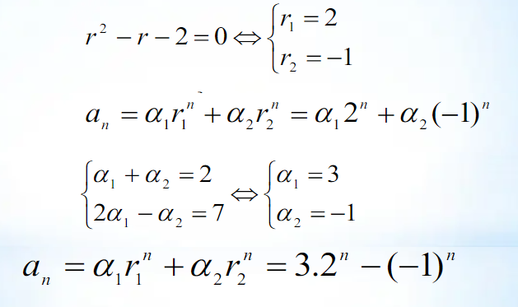
4.1 DEFINITION
Example :
Solve: a_{n}=a_{n-1}+2a_{n-2}
For a₀=2; a₁=7
23

Slide 24

4.1 DEFINITION
Example :
Solve:
$an=an−1+6an−2 n≥2; a0=3; a1=6$
$an=7an−1−10an−2 n≥2; a0=2; a1=1$
$an=13an−1−22an−2 n≥2; a0=3; a1=15$
$an=14an−1−49an−2 n≥2; a0=3; a1=35$
$an=−13an−1−22an−2 n≥2; a0=3; a1=15$
$an=−14an−1−49an−2 n≥2; a0=3; a1=35$
23

Slide 25

4.1 DEFINITION
Theorem 2: Let c₁ c₂ be two real numbers. Assume that the characteristic equation(9) has a double root
r²$−c1\text{r}−$ $c2$ $=0$(12)
Hence, the sequence {a_{n}} is the solution r₀ of the recurrence relation
a_{n}=c₁a_{n-1}+c₂a_{n-2} (13)
If and only if:
$an=α_{1}r_{0}^{n}+{nα}_{2}r_{0}^{n}$ (14)
For n=0,1,2.. And $α_{1}$, $α_{2}$ are constants
25

Slide 26
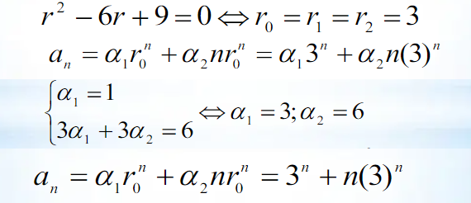
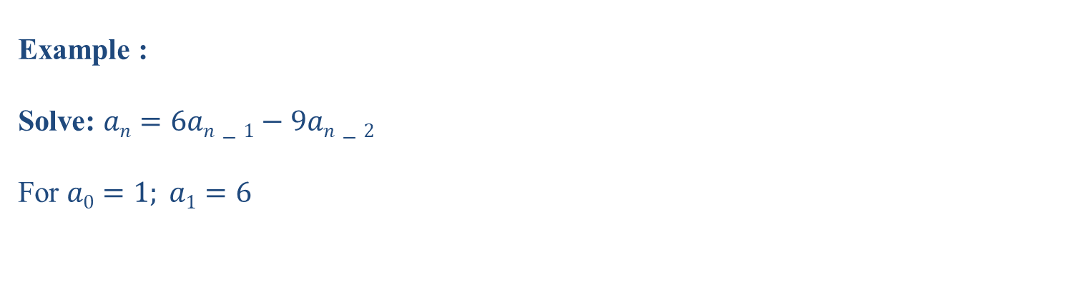
4.1 DEFINITION
Example :
Solve: $an=6an−1−9an−2$
For $a0=1; a1=6$
26

Slide 27

4.1 DEFINITION
Example :
Solve:
$an=4an−1−4an−2 n≥2; a0=6; a1=8$
$an=−4an−1−4an−2 n≥2; a0=0; a1=1$
$an=2an−1−an−2 n≥2; a0=4; a1=1$
$an=−6an−1−9an−2 n≥2; a0=3; a1=−3$
27

Slide 28
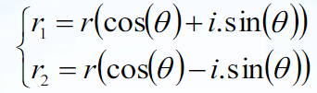

4.1 DEFINITION
Theorem 3: Let c₁ c₂ be two real numbers. Assume that the characteristic equation(12)
r²$−c1\text{r}−$ $c2$ $=0$(15)
has two imaginary solution:
(16)
Hence, the sequence {a_{n}} is the solution r₀ of the recurrence relation
$an=r^{n}{(α}_{1}\cos\left(nθ\right)+α_{2}$ $\sin\left(nθ\right) )$ (14)
For n=0,1,2.. And $α_{1}$, $α_{2}$ are constants
28

Slide 29
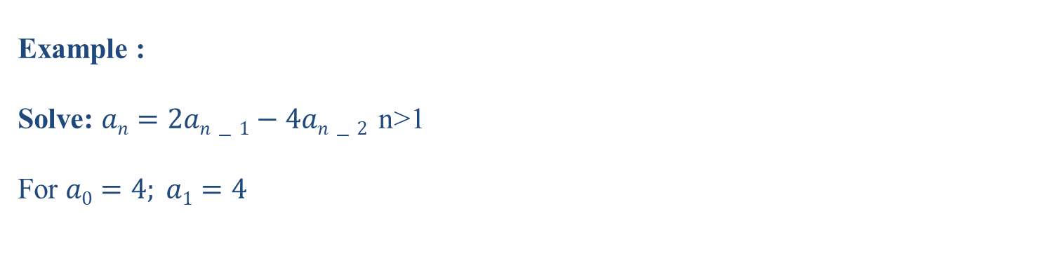
4.1 DEFINITION
Example :
Solve: $an=2an−1−4an−2$ n>1
For $a0=4; a1=4$
29

Slide 30

4.1 DEFINITION
Theorem 4: Let c₁, c₂ , ..c_{k} be real numbers. Assume that the characteristic equation(15)
$rk −c1r{k_1}_{}−…−ck−1r−ck =0$(17)
has k difference solutions r₁ , r₂ ,…, r_{k} :
Hence, the sequence {a_{n}} is the solution r₀ of the recurrence relation
$an=c1an−1+c2an−2+…+ckan−k$ (18)
If and only if:
$an=α_{1}r_{1}^{n}+α_{2}r_{2}^{n}$ +… $+α_{k}r_{k}^{n}$ (19)
For n=0,1,2.. And $α_{1}$, $α_{2}$, …, $α_{k}$ are constants
30

Slide 31

4.1 DEFINITION
Example :
Solve:
$an=6an−1−11an−2 +6an−3 n≥2 For a0=2; a1=5; a3=15$
$an=2an−1+an−2−2an−3 n≥2 For a0=3; a1=6; a3=0$
$an=7an−2+6an−3 n≥2 For a0=9; a1=10; a3=32$
$an=2an−1+5an−2 −6an−3 n≥2 For a0=7; a1=−4;a3=8$
31

Slide 32

4.1 DEFINITION
Solve:
$an=an−1+6an−2 n≥2 For a0=3; a1=6;$
$an=7an−1−10an−2 n≥2 For a0=2; a1=1;$
$an=6an−1−8an−2 n≥2 For a0=4; a1=10;$
$an=2an−1−an−2 n≥2 For a0=4; a1=1;$
$an=an−2 n≥2 For a0=5;a1=−1$
$an=−6an−1−9an−2 n≥2 For a0=3; a1=−6;$
$an=−4an−1−5an−2 n≥2 For a0=2; a1=8;$
32

Slide 33
4.2. SOLVE THE PROBLEM WITH THE MODEL OF REGRESSION.
Problem 1: Hanoi tower
Problem 2: Fibonacci sequence (group working)
Problem 3: Factorial (group working)
33

Slide 34
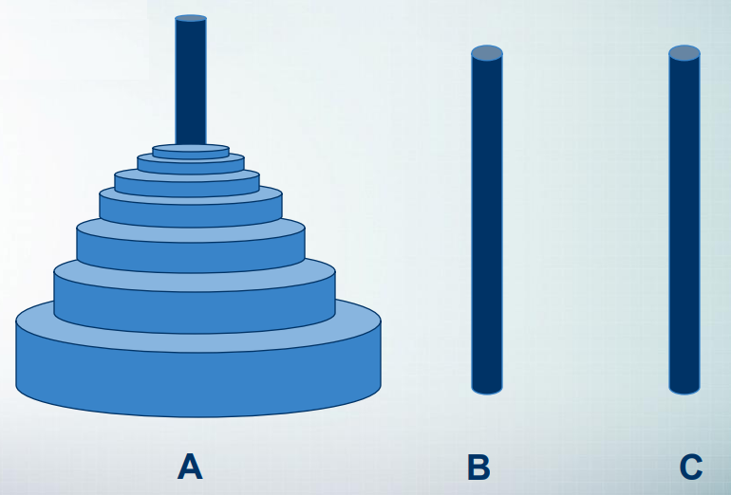
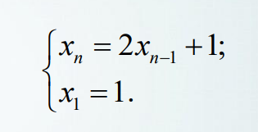
4.2. SOLVE THE PROBLEM WITH THE MODEL OF REGRESSION.
Problem 1: Hanoi tower
34

Slide 35
THANK YOU!

